Slide 1
Accelerating the Clean Energy Transition in Inland SoCal
Discussion of climate, energy, and environmental trends in Inland SoCal, and how CSE and Thrive Inland SoCal are working with our communities to invest in a better future
April 4, 2024
Kara Crohn, Luzita Lutfi, Jin Zhu

Slide 2
Agenda
2:00pm Intro to CSE & Connection to Environmental Justice Work
2:15pm Discussion: What are the most important environmental and health issues in our region?
2:45pm Inland SoCal Climate, Environment, Energy Trends
3:00pm Questions?
3:05pm How CSE-administered Programs and Community Outreach Help Inland SoCal
3:20pm Questions?
3:25pm How to get involved

Slide 3
Intro to CSE & Connection to Environmental Justice Work

Slide 4
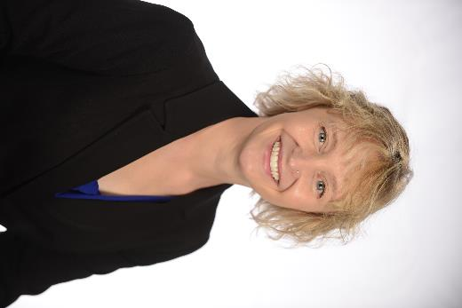
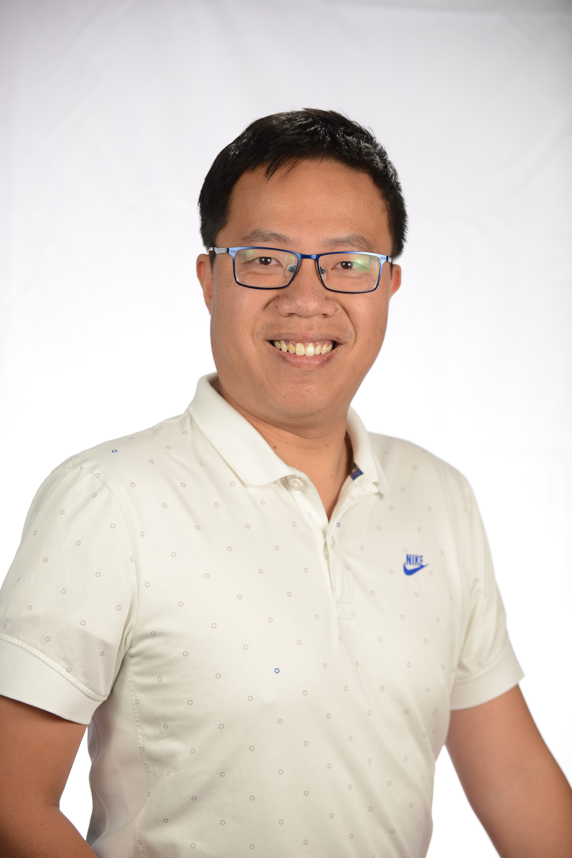

CSE Introductions
Kara Crohn, PhD
Jin Zhu
Luzita Lutfi
Director
Transparency & Insights
Senior Manager
California Transportation Programs
Associate Manager
Equity Engagement & Outreach

Slide 5
Audience Introductions
Who are you?
Name
Organization/School
Role/Area of Interest

Slide 6
About CSE
Center for Sustainable Energy® (CSE) is a national nonprofit that accelerates adoption of clean transportation and distributed energy through effective and equitable program design and administration. Governments, utilities and the private sector trust CSE for its data-driven and software-enabled approach, deep domain expertise and customer-focused team. CSE’s fee-for-service business model frees it from the influence of shareholders, members and donors, and ensures its independence.
Our vision is a future with sustainable, equitable and resilient transportation, buildings and communities.
We have one mission – Decarbonize.®
Notes:
One mission – Decarbonize.®
Depending on the context, you can say, “We have one mission – Decarbonize.®” or leave out the word “mission” and just say: Decarbonize.®
Always capitalize the “D”
Use a dash (EM dash is uppercase hyphen key on the keyboard. Put a space on either side, not a colon, after mission.)
Always include the period at the end of Decarbonize.
Trademark is optional. If used, put it after the period.
Vision
Our vision is a future with sustainable, equitable and resilient transportation, buildings and communities.
Per AP Style, you do not need a comma after equitable or buildings.

Slide 7
Our Focus on Equity & Inclusion
CSE engages people in hard-to-reach, disadvantaged, low-income, and other vulnerable communities to share community-identified solutions that improve public health and address transportation and energy equity
Partner with community-based organizations (CBOs) to ensure we gather important insights for new program designs, administration, outreach and assessment when possible
We have partnered with and funded over 100 CBOs on our Equity outreach projects to ensure we have a complete understanding of each community we serve
We design outreach messaging and material in multiple languages with cultural sensitivity
CSE Equity outreach specialists and CBO partners connect with individuals and families who have been disproportionately impacted by air pollution and other environmental factors to ensure access to EVs and other clean energy incentives and resources
The CSE Policy team shares community-identified, data-driven recommendations to policy makers to expand adoption of clean technologies to low-income individuals and historically underserved communities
CSE's Caret® Affordability Calculator, which shows the incentive levels required to make specific EVs affordable to households of different income levels, has been used to inform federal and state EV incentive policy

Slide 8
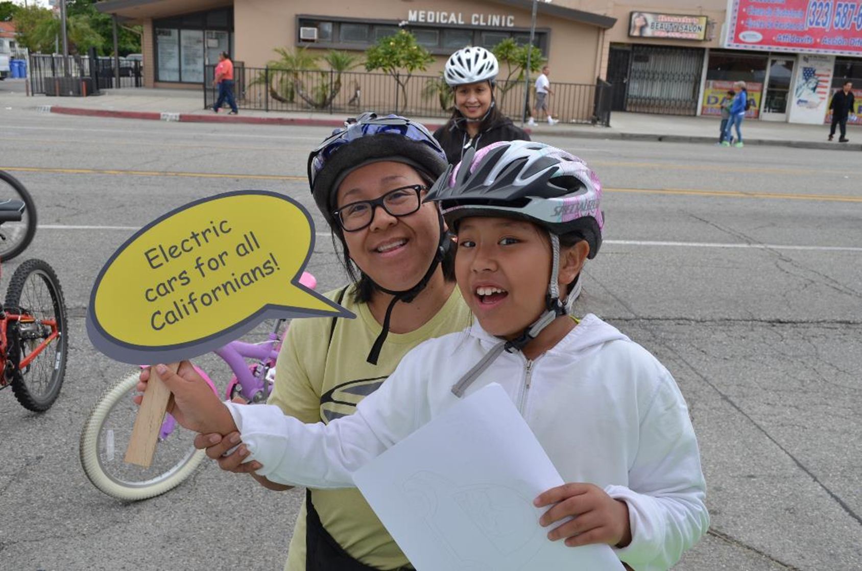
Connection to Environmental Justice
CSE is a clean energy nonprofit with one mission "Decarbonize"
Capacity Building – Partner with CBOs and environmental justice organizations by providing funding, training resources for program feedback and community outreach
Community Outreach and Engagement – Work alongside community organizations to raise awareness and adoption of clean energy programs
Collaborative Projects – Partner on projects aimed at addressing environmental injustices through programs that improve air quality and promote sustainable practices
Policy Advancements – Through our policy teamwork, gather feedback from EJ organizations and CBOs to develop and/or advance EJ program principles
"Nothing About Us Without Us"

Slide 9
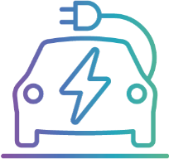


$4B+ Program Management Portfolio
EV Incentive Programs: $2.3B+
CA – Clean Vehicle Rebate Project
CT – CHEAPER
DE – Clean Vehicle Rebate Project
MA – MOR-EV
NJ – Charge Up New Jersey
NY – Drive Clean NY & Truck Voucher
OR –Clean Vehicle Rebate Program
VT – PEV, Replace Your Ride, E-Bikes
Utility EV programs (PG&E, SCE)
Over 600,000 rebated vehicles
EV Charging Incentive Programs: $500M
CA – CALeVIP
MA – MassEVIP
NJ – Residential Charger Program
NY – Charge Ready New York
PA ­– EVSmart
Distributed Energy: $1.3B
CA ­­– Solar on Multifamily Affordable Housing
CA – Self-Generation Incentive Program
$10M utility-funded solar program for low-income San Diego homeowners
CA - Energy Storage Permitting Guidebook
8,400 projects funded
Funding issued for:
6,000+ L2 chargers
1,400+ DCFC connectors

Slide 10
EV Rebate/EV Infrastructure Programs Covering 105 Million Americans
CALIFORNIA
CALeVIP
CVRP
Bear Valley Electric EVI
Central Sierra ZEV
DOE VCI-MUD LA Bureau of Streetlighting
DOE VCI-MUD San Francisco, San Mateo and Campbell
Irvine ZEV Transition Plan
Los Angeles Clean Cities
PG&E Used EV
Port of San Diego
Sac Metro AQMD CC4A
San Bernardino ZEV
San Diego County EV charger plan
San Diego County Green Fleet Action Plan
San Diego Regional Clean Cities
SCE Clean Fuel Reward Program
SCP eBike
CONNECTICUT
CHEAPR
DELAWARE
CVRP
GEORGIA
DOE VCI-MUD Atlanta
ILLINOIS
Chicago Area Clean Cities
DOE VCI-MUD Chicago Commonwealth Edison
INDIANA
South Shore Clean Cities
LOUISIANA
LADOT NEVI Plan Support
MARYLAND
Maryland Clean Cities
DOE VCI-MUD Takoma Park
MASSACHUSETTS
MOR-EV
MOR-EV MD/HD
MassEVIP
Boston University Campus Fleet
NEW MEXICO
Public Service Company of New Mexico (PNM)
NEW JERSEY
Charge Up New Jersey
NEW YORK
Charge Ready NY
Drive Clean NY
NY Truck Voucher Program
Clean Communities of Central New York
OKLAHOMA
Tulsa Area Clean Cities
OREGON
OCVRP
OCVRP Equity & Dealer Outreach
Columbia-Willamette Clean Cities
DOE VCI-MUD Portland
PENNSYLVANIA
PennDOT NEVI Implementation Plan Team
PECO EVsmart
UTAH
DOE VCI-MUD Salt Lake City
VERMONT
Vermont New PEV, Replace Your Ride, E-bikes
VIRGINIA
Virginia Clean Cities
WASHINGTON
Seattle City Light
DOE VCI-MUD Seattle 2030 District
DOE VCI-MUD Snohomish County PUD 1
Western Washington Clean Cities
WASHINGTON, D.C.
Greater Washington Region Clean Cities
WISCONSIN
Wisconsin Clean Cities
Statewide incentive programs
Drive Electric USA Project Advisory Committee
EV Infrastructure
Light Duty EVs
Medium/Heavy Duty EVs
Electric Bikes
Notes:
Please add Engagement symbols for: Virginia, Maryland, Minnesota, Michigan, Texas, Illinois, Washington state
Add a Heavy Duty EVs symbol in Mass.

Slide 11


Transparency & Insights (T&I)
Insightful research and analytics to fuel effective, efficient, equitable decarbonization programs
Data Dashboards
Caret Software Platform
Program Research
Data visualization tools to track program KPIs, including funding levels and impacts
Transparency and on-demand reporting for stakeholders
Platform providing EV and EVI program forecasting, analytics, and charging session-level data knowledgebase
Automation of EV charger infrastructure siting to optimize user-defined goals
Quantitative and qualitative research by team of 30 experts in social, behavioral and data sciences
Consumer insights based on interactions with 600,000 new EV buyers

Slide 12
Small Group Discussion (15 min)
What are the most pressing environmental justice and energy concerns in our region?

Slide 13
State of the Climate in Inland SoCal

Slide 14
Climate Key Findings
Inland SoCal Surface temperatures are 2.6°F - 3.5°F higher in equity communities*
​
Temperatures are projected to rise from an average of 81°F in 2023 to 88°F by 2100
Extreme heat events are projected to double every 15 years from 2009 to 2038
Heat event days increase: average of 14 days per year in 2009-2023 to average of 21.5 days in 2023-2037
Top GHG-emitting sectors in the state (2000 to 2020): transportation (38%), industry (23%)
San Bernardino (2016): transportation (51%) and building energy (35%)
Riverside (2017): transportation (36%) and agriculture (34%)
Current climate mitigation strategies primarily target energy and transportation sectors
32% of reviewed programs addressed these sectors
*Equity communities are census tracts with identified low-income communities and disadvantaged communities as defined by the state.

Slide 15
Climate – Methods
Cal-Adapt Climate Data Models
Temperature
Precipitation
Relative humidity
Heat events
Extreme precipitation
LANDSAT 8 TIRS data
Surface temperature
Secondary Literature Review
GHG methodologies
Regional Climate Action Plans
Climate mitigation program descriptions & reports
Extreme heat event reports

Slide 16
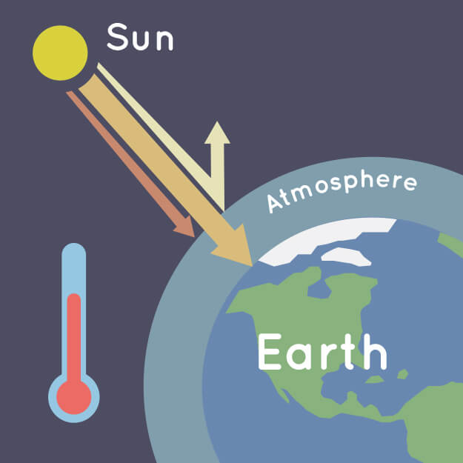
Climate – GHG
Why are we reporting greenhouse gas emissions and programs designed to avoid them?
Greenhouses allow plants to grow year-round because the glass walls trap heat from the sun and keep it from getting too cold. The greenhouse effect works much the same way on Earth. Gases in the atmosphere, such as carbon dioxide, trap heat similar to the glass roof of a greenhouse. These heat-trapping gases are called greenhouse gases and keep Earth much warmer than what it would be without an atmosphere.
https://climatekids.nasa.gov/greenhouse-effect/
Notes:
Comment on difference between GHG and pollution burden

Slide 17
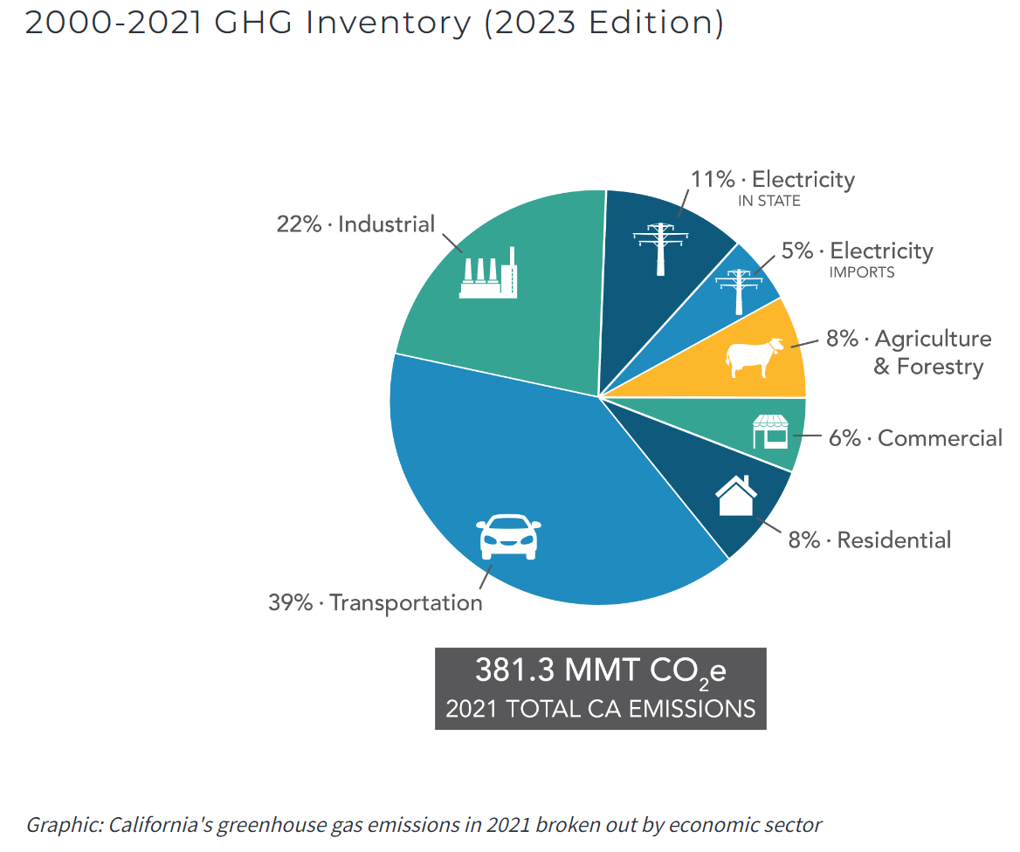
Climate – GHG
Top GHG-emitting sectors in the state (2000 to 2020):
Transportation (38%)
Industry (23%)
San Bernardino (2016):
Transportation (51%)
Building energy (35%)
Riverside (2017):
Transportation (36%)
Agriculture (34%)
California Air Resources Board “Current California GHG Emission Inventory Data”
Notes:
Whereas the pollution burden is a combination of local sources and air pollutants generated outside of our region including NOx, SOx, PM10, PM2.5 from the ports, heavy-duty transportation and other sources, GHG emissions are gasses such as carbon dioxide, methane, and nitrous oxide generated from within our region.

Slide 18
State of Energy in Inland SoCal

Slide 19
Energy Key Findings​
Top electricity consumers (reported by Southern California Edison, SCE) are residential (36%), commercial (31%), and then industrial (29%)
Electricity consumption has increased 11% from 2018 to 2022 and is projected to further increase by 8.3% to 25% by 2031, depending on electric vehicle use
Inland SoCal is prioritizing renewable energy, with solar power plants being installed at the greatest rate across all energy sources in terms of quantity (7%) and generating capacity (33%) since 2020
Generative capacity of renewable energy sources has increased 274% from 2000-2023, however, natural gas remains the primary energy source (56%)
Clean energy job median wages are significantly higher (24.8 %) than national median wages in sectors such as retail, services, recreation, and accommodations
Notes:
Residential home typical demand – 400-800 kWh/month
Typical residential solar installation is around 3-9kW system

Slide 20
Energy – Methods​
Geospatial analysis of existing infrastructure
Powerplants
Distributed energy resources
Advanced modeling of projected electric vehicle (EV) adoption and projected electric vehicle infrastructure that will be necessary to support the growing EV fleet
7+ primary research interviews with energy experts
9+ secondary research of regional reports, industry reports, and white papers

Slide 21
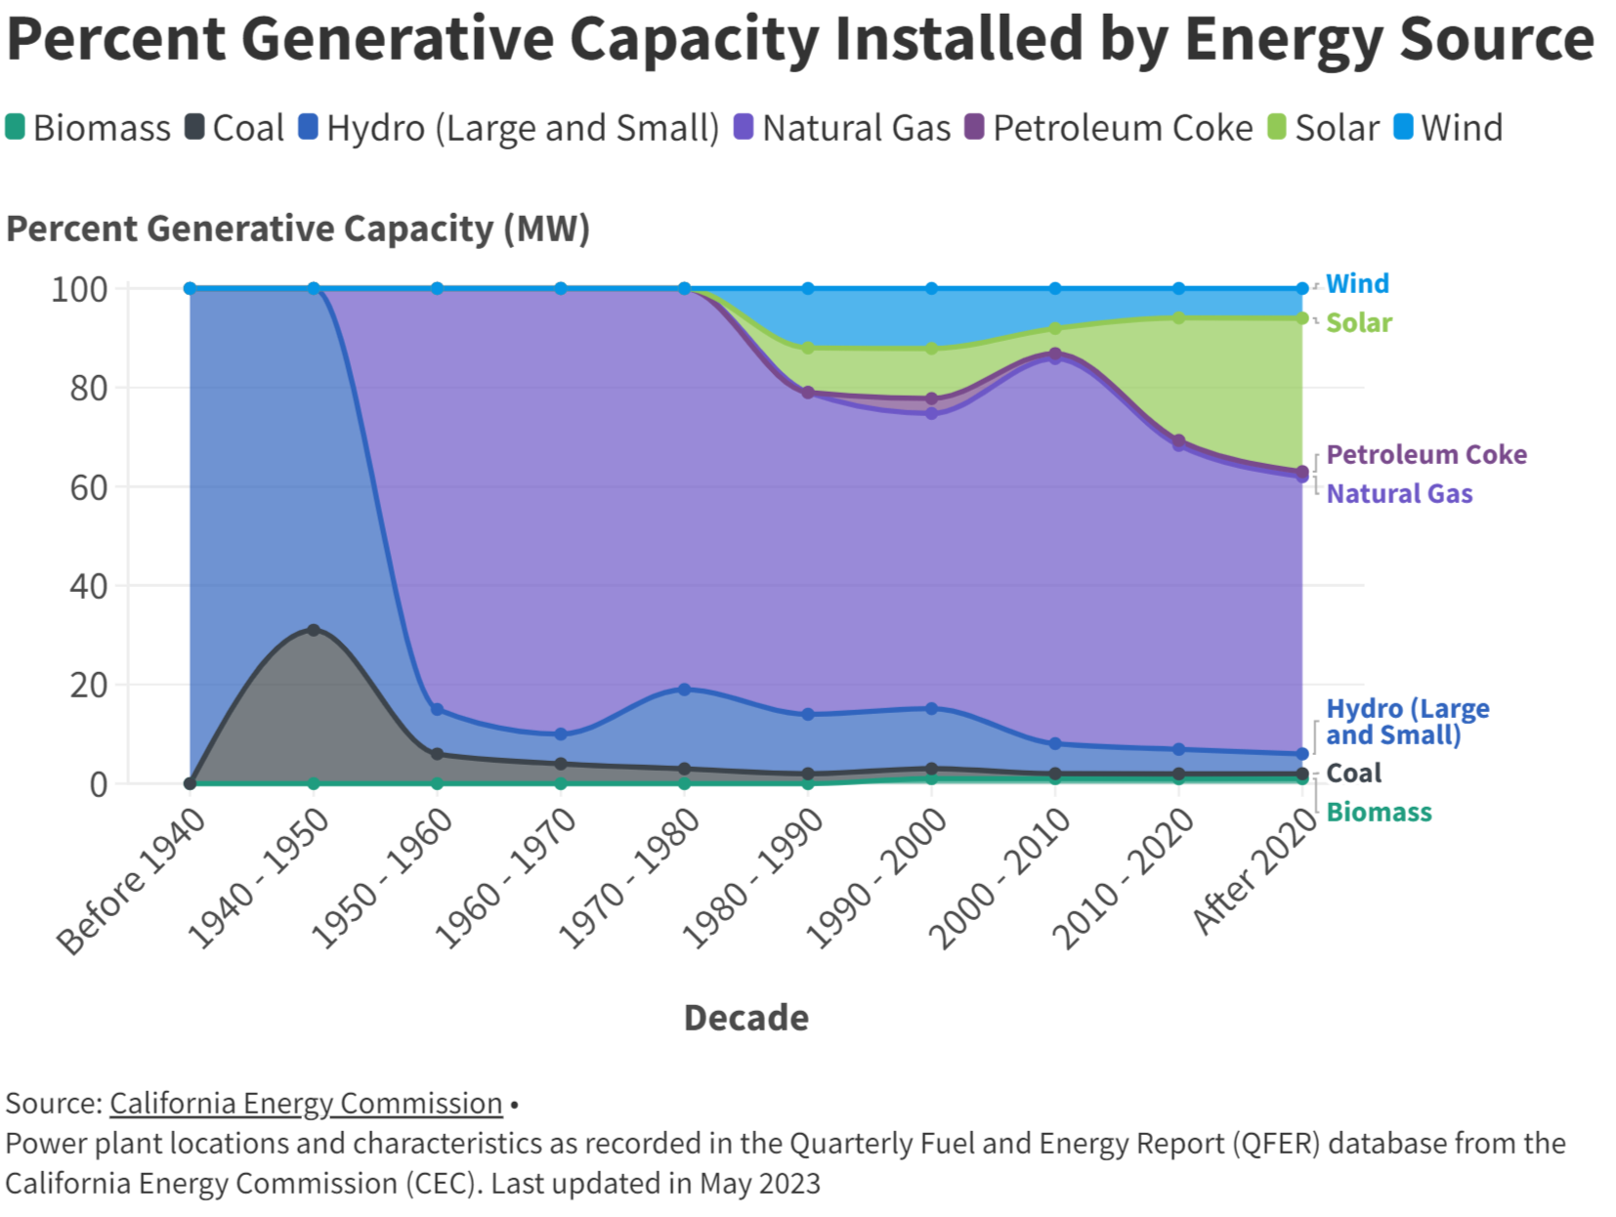
Energy – Capacity​
Power generation has started to shift more toward renewable energy sources
Renewable energy adoption is gaining momentum in Inland Southern California, with solar energy leading in recent decades
Natural gas continues to generate a majority of power (approximately 60%)
**caveat: installations inside Inland SoCal are not guaranteed to provide power to Inland SoCal residents
Notes:
Decommissioned Sites
Inland Empire Energy Center (natural gas-fired power plant) decommissioned/demolished in 2020
New Projects
PG&E is proposing nine new battery energy storage projects totaling about 1,600 MW, to be added to California's electric grid by 2024
Beaumont Energy Storage project in Beaumont, California scheduled to be online by August 2023
Inland Empire Energy Storage project in Rialto, California (San Bernardino County), expected to be operational by April 2024 and contracted to produce capacity of 400 MWh by summer 2024
Transformations
Former site of Inland Empire Energy Center is planned to be transformed into a large-scale battery storage system by Nova Power LLC. designed to better meet the state's peak power needs
Innovation and Community Engagement
UC Riverside's Office of Technology Partnerships is leading the Inland Empire in the Southern California Energy Innovation Network (SCEIN) for an extended period of five years.
Expansion of the SCEIN Inland Empire network by engaging with startups and over 30 regional organizations committed to energy generation or storage.

Slide 22
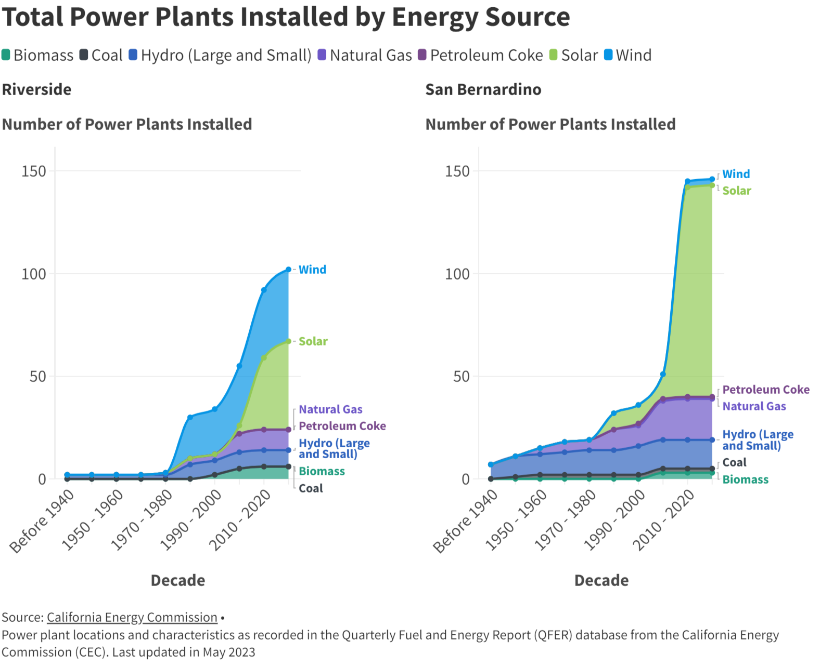
Energy – Power Plants​
More wind and solar energy power plants installed
In recent years, a greater percentage of power plants using renewable resources have been installed
Riverside installed more wind
San Bernardino installed more solar
Number of natural gas and hydro (large and small) power plants has remained relatively consistent since 2000
**caveat: installations inside Inland SoCal are not guaranteed to provide power to Inland SoCal residents

Slide 23
Energy – Electric Vehicle Infrastructure​
In Inland SoCal region, EV charging infrastructure is expected to grow
Level 2 chargers are expected to grow 600% from 2023 to 2030 and 231% from 2023 to 2050
DC fast chargers are expected to grow 26% from 2023 to 2030 and 59% from 2023 to 2050
Across California, barriers to charging at home persist*
86% of surveyed CVRP rebate recipients charge at home
36% rely on a 120-volt outlet for home charging (a standard outlet that can be used for a toaster or hair dryer); 23% have a Level 2 charger
56% rent or have a homeowners association and are not authorized to make changes at their residence
21% said adding an outlet or charging station would be too expensive
15% said it would be too complicated
As more EV charging becomes available, EV adoption may further increase**
* Alvarez, F. (2023) “Incentives, Resources Guides can Expand Access to EV Charging” **Okoma, M. (2023)“The impact of Electric Vehicle Charging Stations on Light Duty Electric Vehicle adoption and rebates California”

Slide 24
Energy – Clean Energy Jobs​
Clean energy jobs pay better
Nationally, median wages in clean energy are significantly (24.8 %) higher than national median wages in sectors such as retail, services, recreation, and accommodations, especially when it comes to entry-level wages. On average, in 2019:*
>$25/hr.
Wind and grid modernization
$24.48/hr.
Solar energy workers
$24.44/hr.
Energy
efficiency
$24.37/hr.
Coal, natural gas and petroleum fuels pay less
Inland SoCal has high rate of clean energy employment - 42,574 jobs (54.2% of all renewable and nonrenewable energy jobs)
Riverside County - 7th in the state, 15th in the nation
San Bernardino County - 9th in the state, 28th in the nation
Of these jobs, 52.5% are associated with energy efficiency and 22% with renewable energy
Southern California has 7 programs dedicated to green energy jobs training
Riverside City College Advanced Hybrid and EV Technology
San Bernardino Community College EV/Hybrid Automotive Repair
Pre-Apprenticeship Training Programs Riverside and San Bernardino Counties
Zero Emissions Vehicle Equity Training Project
Grid Alternatives Clean Tech Training Center (Riverside)
Southern California Regional Energy Network (SoCalREN) Workforce Education and Training Program
SoCal IREN Green Path Careers
*Source: Environmental Entrepreneurs [E2], et al., 2020. Analysis built on 2020 U.S. Energy and Employment Report (USEER) by the Energy Futures Initiative (EFI) in partnership with the National Association of State Energy Officials (NASEO)
Notes:
Tell personal career story here.

Slide 25
State of Environment in Inland SoCal

Slide 26
Environment Key Findings
Significant land use change from agriculture to urban and industrial development
Cropland has decreased 32% while urban/developed lands have nearly doubled
Warehouses are identified as a key area of concern regarding land use change and air quality; in past decade 1/3 of urban area growth has been warehouses
Major pollutants are from transportation, particularly heavy-duty vehicles and port activity, as well as industrial activities, agricultural, and natural events (e.g., wildfire)
Dense urban areas, warehousing districts, and areas near transportation corridors are in the top 20% of exposure to diesel particulate emissions and are also more likely to be classified as disadvantaged communities
Ozone levels have in recent years have stopped their trend of improving
Rise in extreme heat events will likely lead to increased drought and increased frequency of wildfire
Increased risk of degraded air quality, negative impact on water systems, post-fire rains triggering debris flow, negative impact on agriculture

Slide 27
Environment – Methods
Data analysis
CARB air quality data
USDA soil survey data
California Department of Conservation Farmland Mapping and Monitoring Program data
Cal-Adapt data
8+ primary research interviews with government officials and environment experts
15+ secondary research of academic literature, regional reports, and other white papers

Slide 28
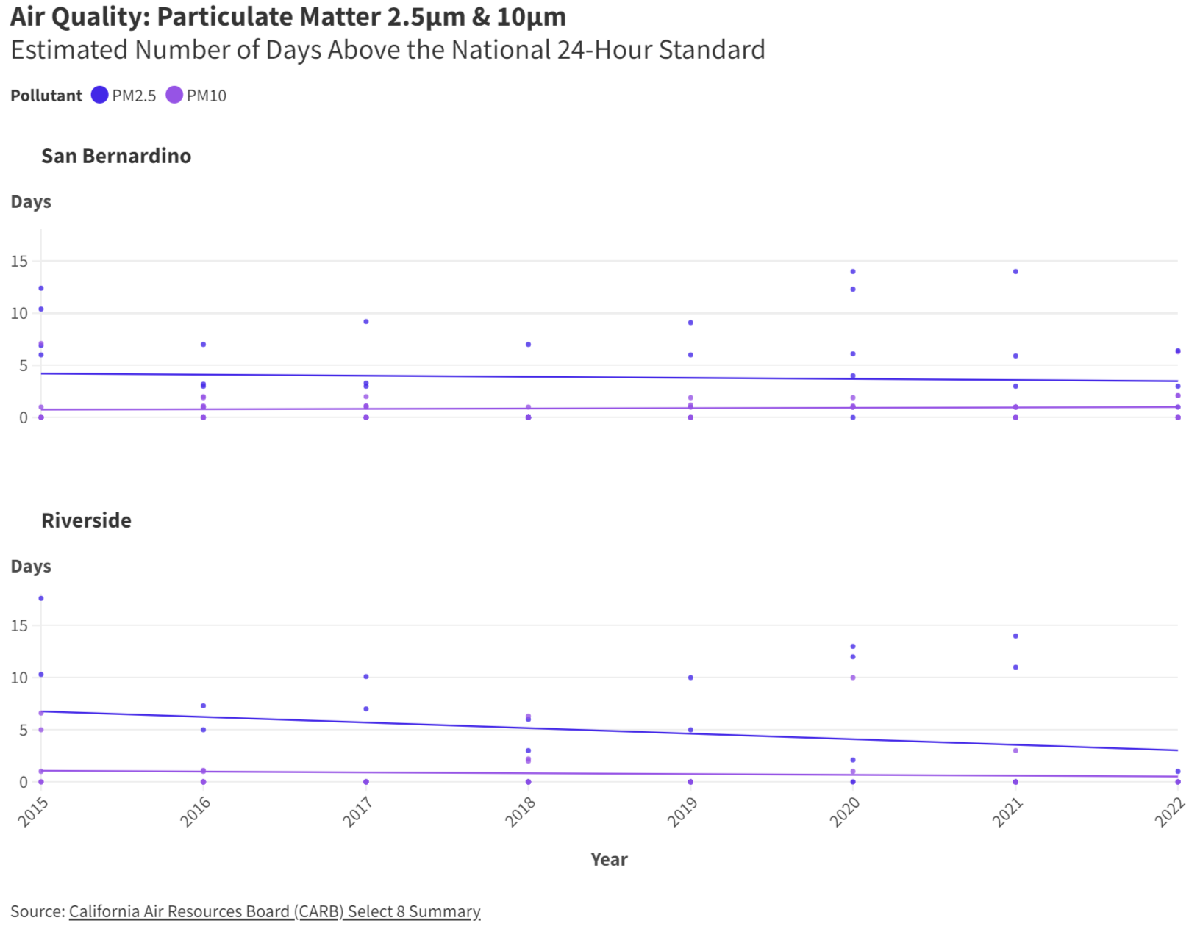
Environment – Air Quality
Inland SoCal primary air pollutants:
Ozone
Particulate matter (both PM10 and PM2.5)
Nitrogen dioxide (NO2)
Sulfur dioxide (SO2)
Carbon monoxide (CO)
Inconsistent air quality monitoring makes it difficult to assess true pollution burden
In recent years, ozone levels have stalled or worsened trends in specific areas, signaling need for more robust interventions
Rise in temperatures and continued poor air quality (PM2.5, PM10, ozone) compound public health risks
PM2.5
14 days
PM10
1 day
PM2.5
14 days
PM10
3 days

Slide 29
How CSE-administered Programs and Community Outreach Help Inland SoCal

Slide 30
CSE’s Impact via Programs & Outreach
Nationally, the programs CSE administers will reduce nearly 13 million metric tons of carbon dioxide equivalent over lifetime of programs
Equivalent of saving emissions from driving a gasoline-powered car around the Earth 1.3 million times
Within Inland SoCal, CSE administers key programs that help decarbonize transportation and buildings
Electric vehicle rebates: CVRP, SCE Pre-Owned Electric Vehicle
Electric vehicle infrastructure incentives: CALeVIP
Distributed energy: SOMAH
We partner and fund CBOs that work in the Inland SoCal communities to create capacity building for the CBO organizations and provide tools and training for the CBOs to have strong outreach and engagement with our community members
In SoCal, CSE supports tribal climate action plans, workforce development, and CBO capacity building

Slide 31




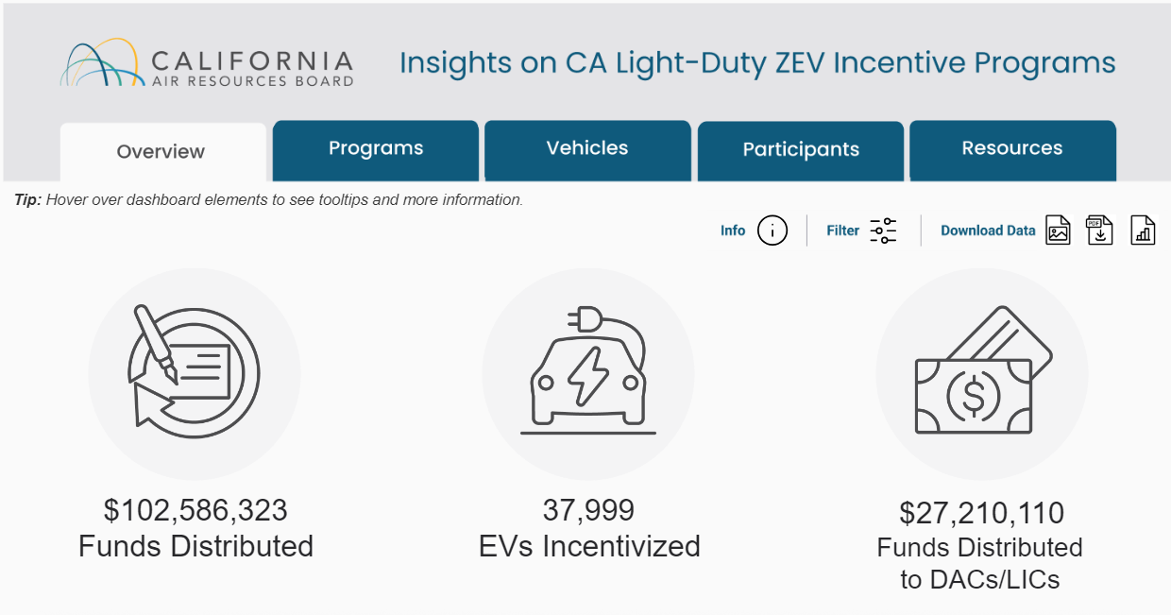
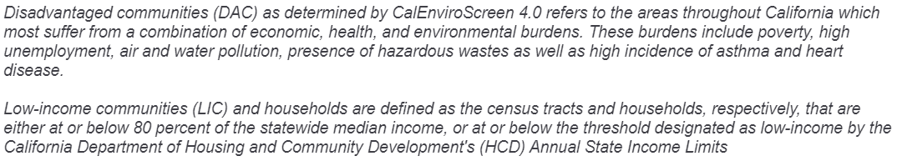
CARB Electric Vehicle Programs 2010-2024
CARB EV rebate statistics in Riverside and San Bernardino counties
https://calzevinsights.org/
Inland SoCal EV buyers benefited from California Air Resources Board (CARB) incentives over past 14 years
Over $102.6M in incentives for Inland SoCal EV buyers
26.5% of incentives to DAC/LIC residents
95% of incentives from CVRP

Slide 32
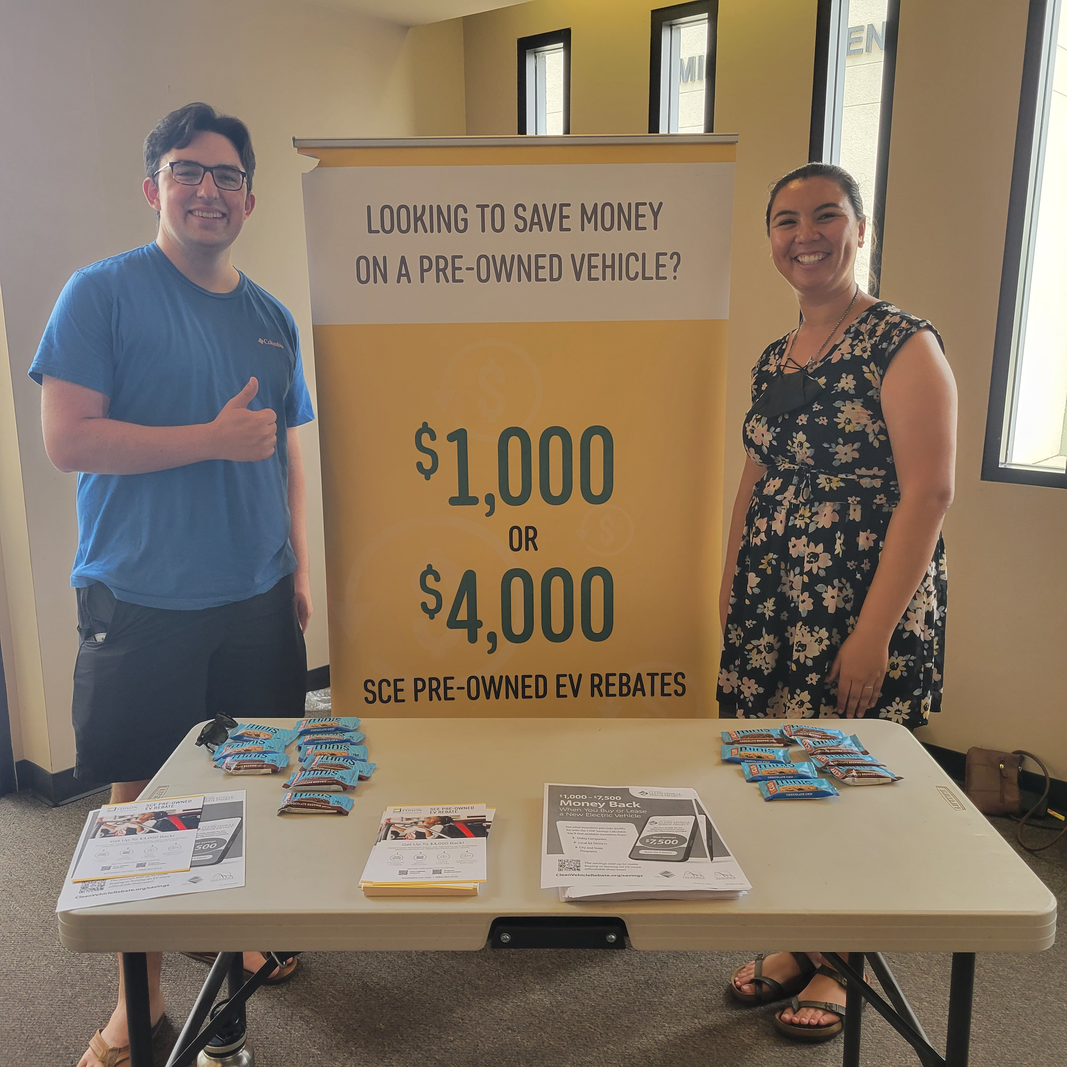

SCE Pre-Owned EV Rebate Program
Provides post-purchase incentives on used EVs purchased through individuals or dealerships
$1,000 – standard
$4,000 – Rebate Plus (income qualified)
Application must be submitted within 180 days from purchase
Must be a SCE customer to qualify
For more information please visit: https://evrebates.sce.com/

Slide 33

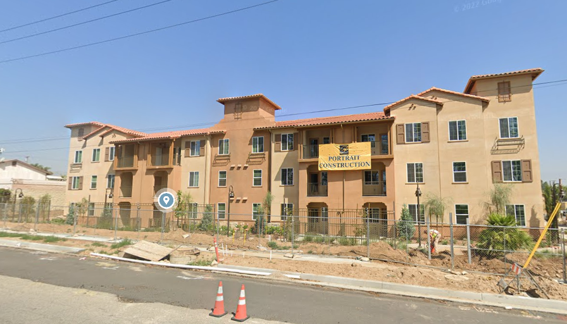
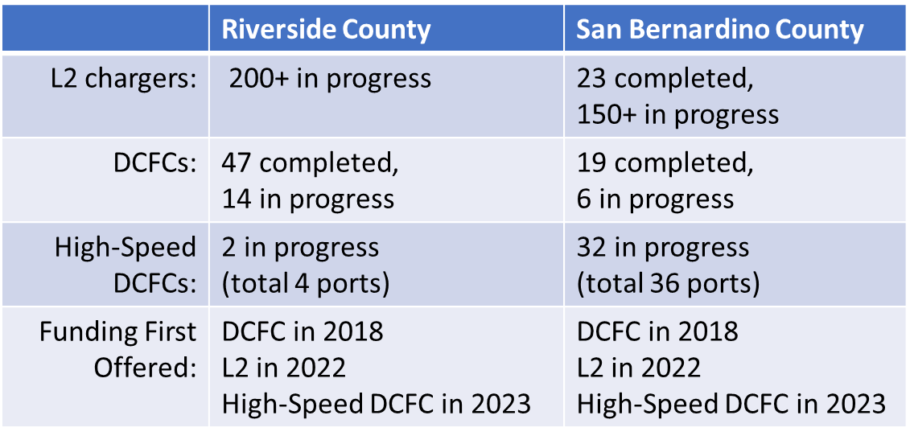
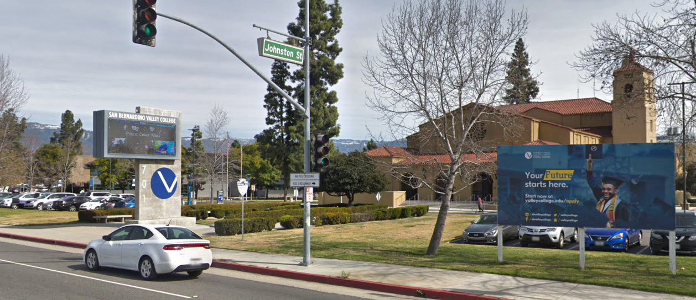
CALeVIP – Inland SoCal
CALeVIP provides funding for installing publicly available EV charging stations to support the rapid adoption of electric vehicles across California
CALeVIP includes project-specific equity requirements:
First regional projects were 25% focused on low-income and disadvantaged communities
Current program is focused 100% on equity communities
CALeVIP funded the Level 2 chargers at this Multifamily Housing in San Bernardino
CALeVIP funded chargers at San Bernardino Valley College

Slide 34






SOMAH Benefits to the Community
SOMAH is dedicated to equity through a community-based approach that amplifies the voices of those most burdened by social and environmental factors and ensures the program listens to and is responsive to the communities it serves
Incentivize solar adoption on multifamily affordable housing
Install 300 megawatts of generation capacity by 2032
Benefit owners and tenants
Increase energy efficiency + offset emissions
Creates local jobs

Slide 35
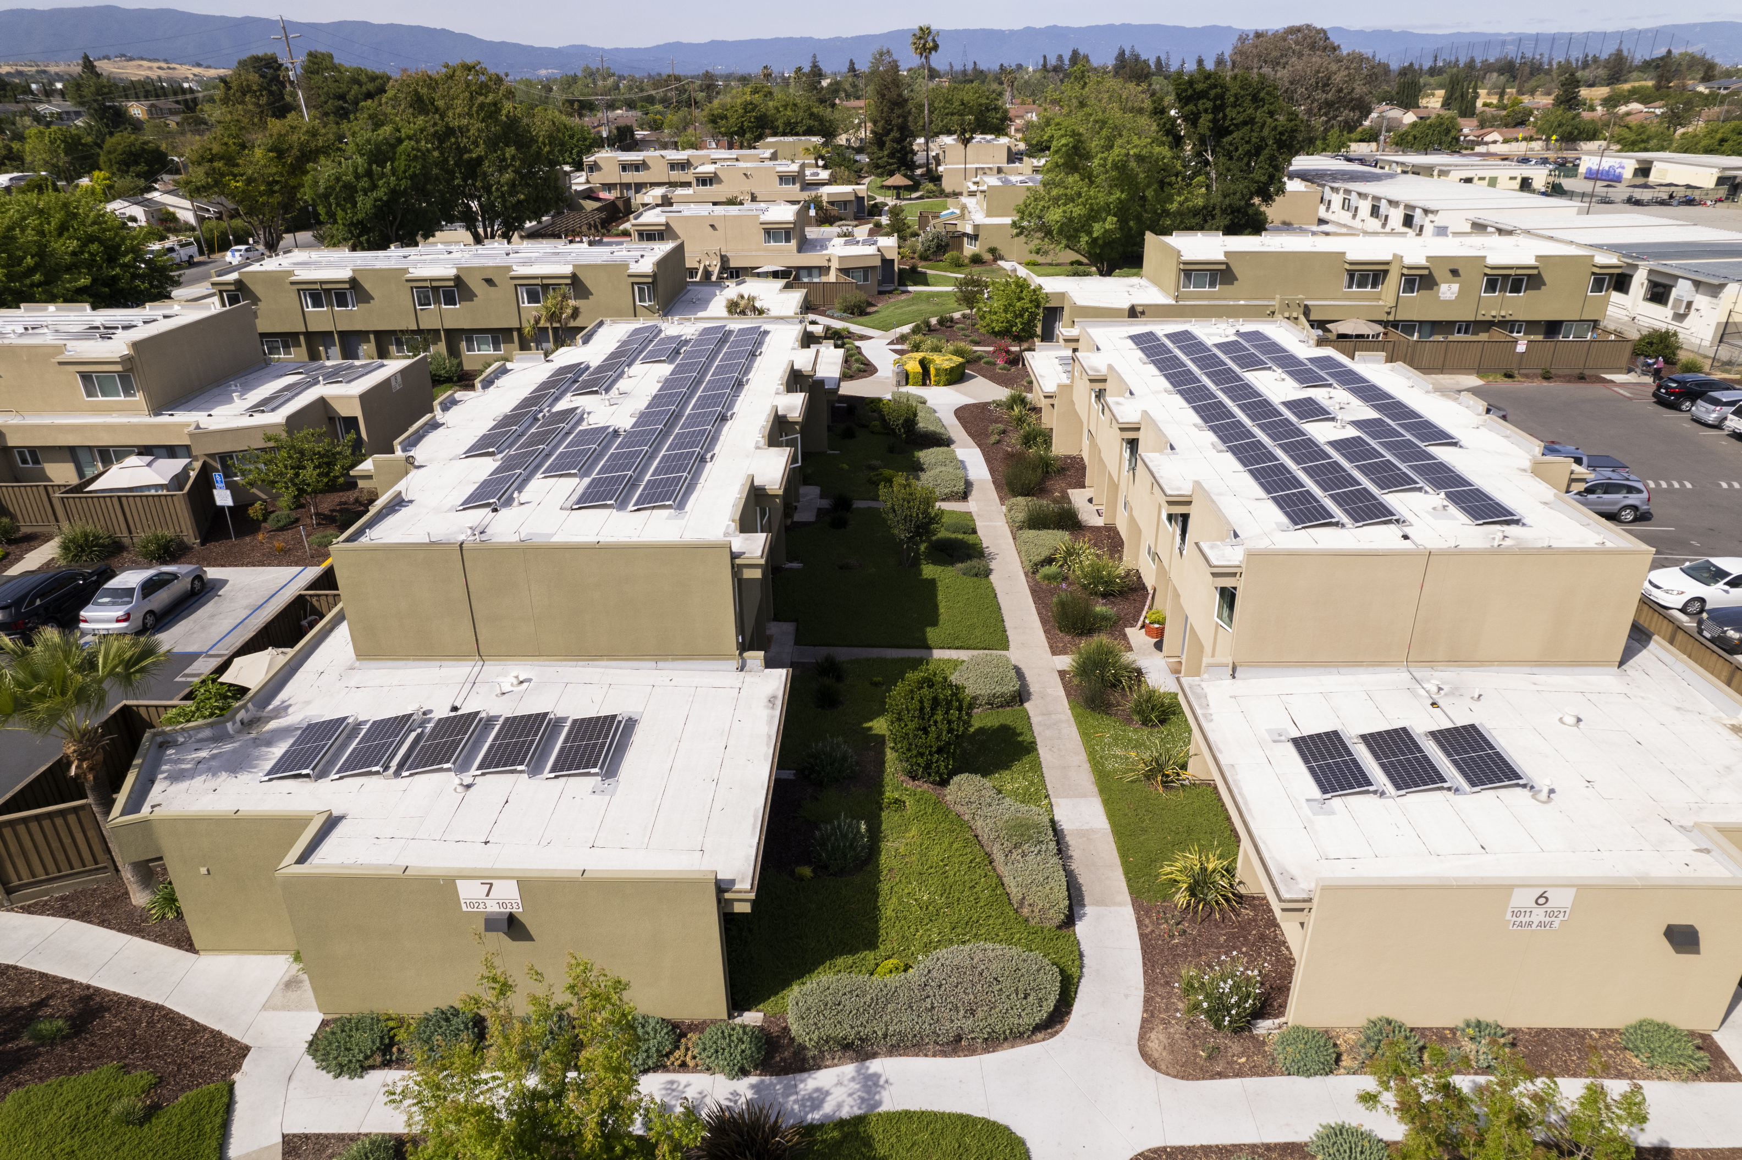
SOMAH - A Commitment to Equity
Energy and Environmental Justice are in SOMAH’s DNA
Created largely by the advocacy efforts of environmental justice groups and funded by greenhouse gas auction proceeds through California's Cap-and-Trade Program, SOMAH’s work to expand clean energy access to low-income and environmental justice communities in particular has clear restorative and environmental justice implications

Slide 36
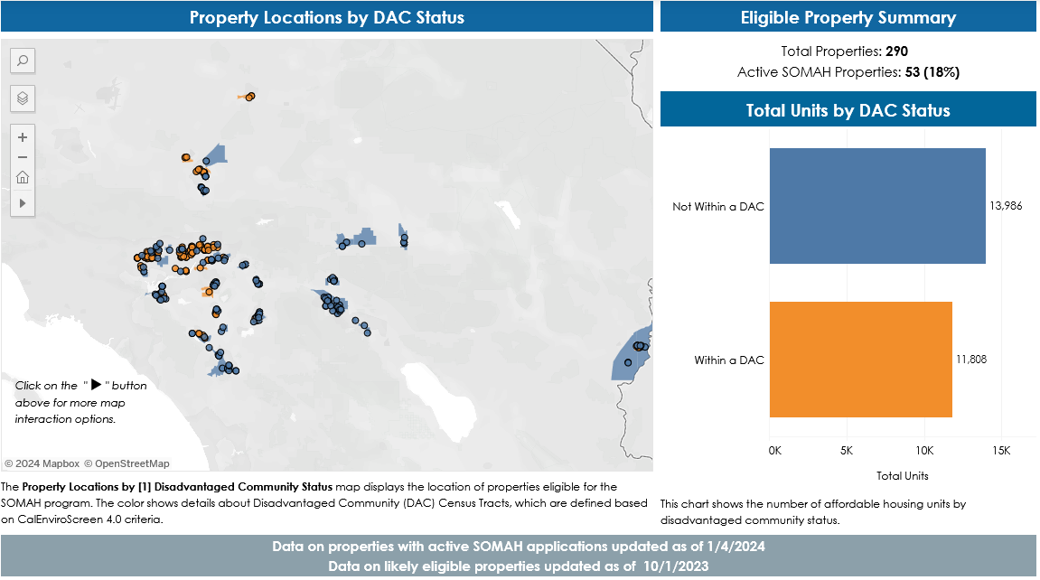
SOMAH Eligible Inland SoCal Properties

Slide 37
Thrive Inland SoCal

Slide 38
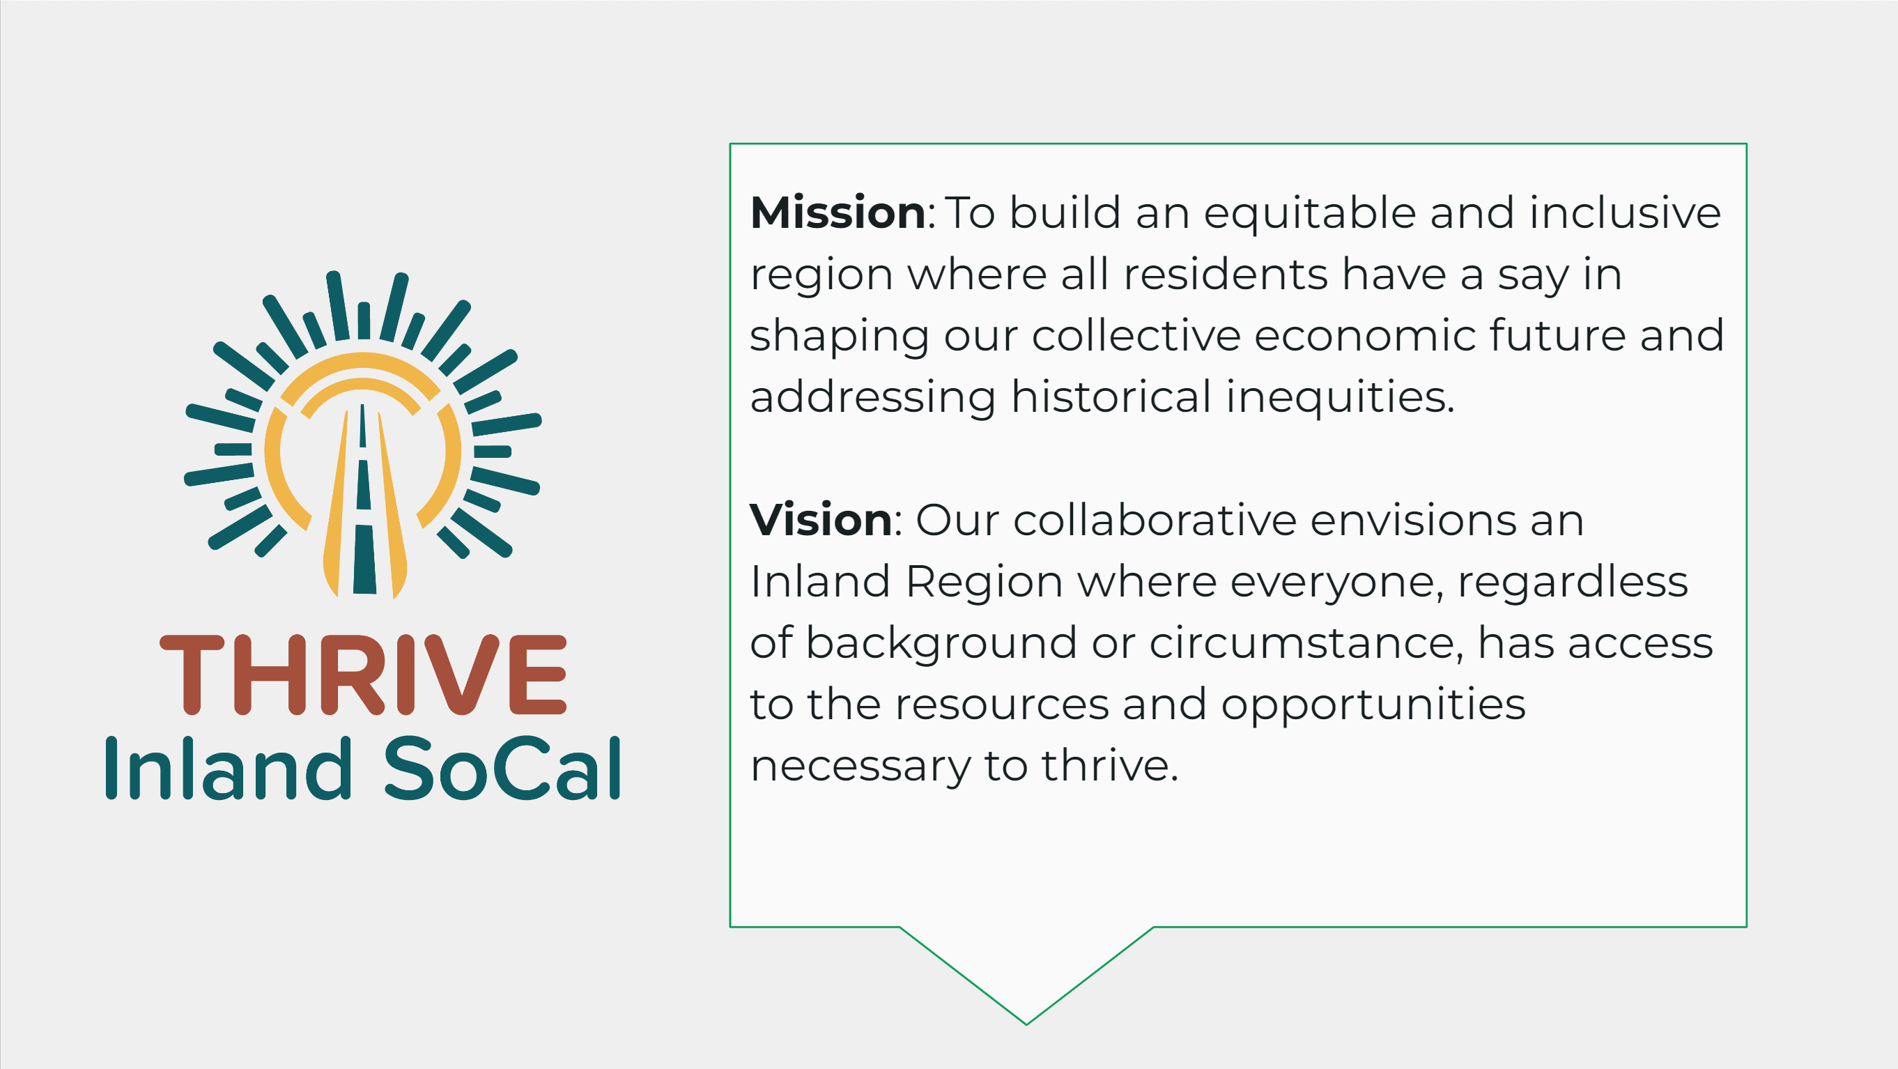

Slide 39


Slide 40
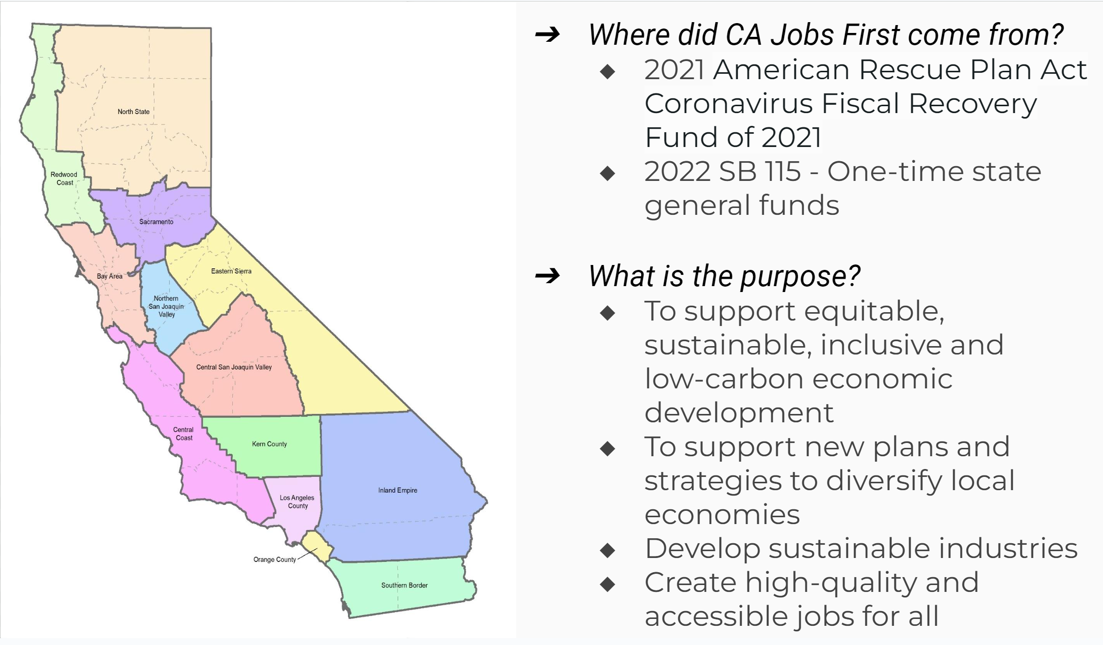

Slide 41
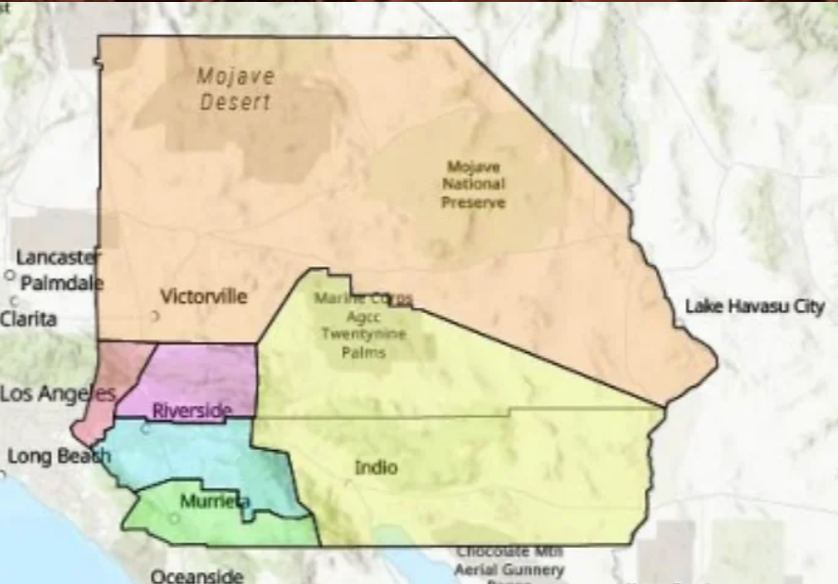
Thrive Inland SoCal Subregional Tables
Six Subregional Tables:
High Desert
Inland Coalition for Immigrant Justice
Western San Bernardino
Reach Out
Greater San Bernardino
San Bernardino Superintendent of Schools
Greater Riverside
Amplify Communities – National Core
Southwest Riverside
The Economic Development Coalition
Coachella Valley
International Brotherhood of Electrical Workers, Local 440
Invited to Join:
Labor
Business
Community Government
Indigenous communities
Economic Development
Philanthropy
Education
Workforce
Community Organizations
Grassroot Organizations
Youth
Residents

Slide 42
Questions & Answers
What questions do you have about CSE’s work or about Thrive Inland SoCal?
What organizations do a good job of supporting environmental justice in Inland SoCal?

Slide 43
How to Get Involved
Attend Thrive Inland SoCal subregional table meetings in April – June 2024 https://www.thriveinlandsocal.org/
Follow CSE
Thought leadership https://energycenter.org/thought-leadership
Energy Loop Newsletter https://energycenter.org/energy-loop-newsletter
Investigate clean energy incentives for your community or your family
SCE Pre-Owned EV Program
SCE solar programs https://www.sce.com/residential/generating-your-own-power
DriveClean https://driveclean.ca.gov/
Become an IREN Energy Fellow https://www.iren.gov/163/Energy-Fellowship

Slide 44
Extra Slides From Research

Slide 45
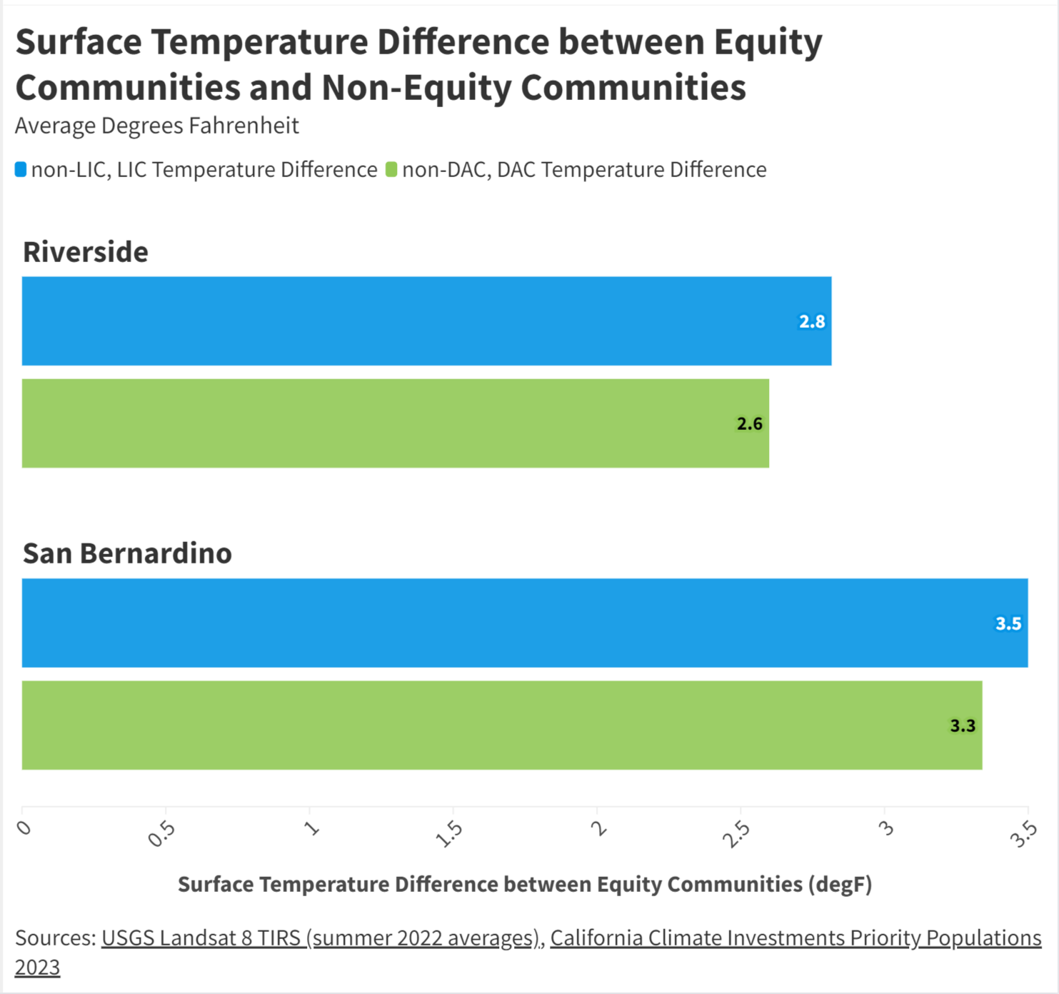
Climate - Temperature
Surface temperatures are 2.6°F - 3.5°F higher in equity communities​ - Disadvantaged (DAC) and low-income (LIC) communities
LICs have a greater magnitude of difference than DACs
LICs: on average 2.8°F - 3.5°F hotter than non-LICs
DACs: on average 2.6°F - 3.3°F hotter than non-DACs
Places with higher temperatures (surface & air)
Have lower vegetation
Correlated with lower household income & greater proportion of non-white residents
How to read the chart:
The bars here indicate, on average, how much warmer equity communities are than non-equity communities. For example, the first bar indicates that low-income communities in Riverside are - on average - 2.8°F hotter than more well-off communities

Slide 46
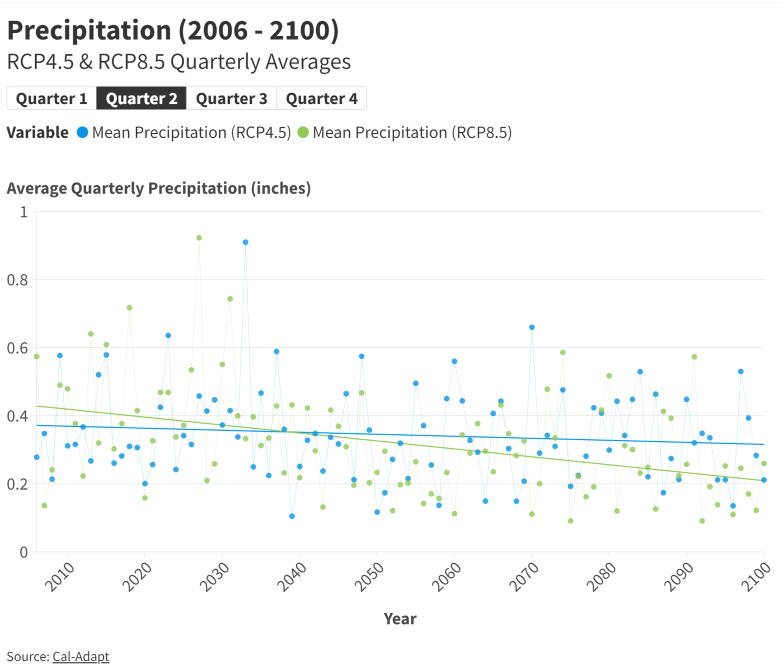
Climate - Precipitation
Inland SoCal precipitation projected to become more extreme over time
Wet months will be wetter
Dry months will be dryer
Precipitation amounts in events typically seen once every 20 years could increase by over 50% by the end of the century.
Relative humidity projected to decrease
Precipitation may decrease more if emissions continue to rise
For each climate variable, RCP* 8.5 has a greater magnitude than RCP 4.5
Reduced snowpack likely to lead to more frequent water shortages and less water available to State Water Project and other water supply systems
RCP 4.5 & 8.5 - Representative Concentration Pathway (RCP) greenhouse gas concentration trajectories. Each pathway describes different climate change scenarios and are labeled after a possible range of radiative forcing values in the year 2100 (4.5, 8.5 W/m^2).
RCP 4.5 is the IPCC’s intermediate scenario, RCP 8.5 assumes that emissions continue to rise throughout the 21st century. Originally published in IPCC’s Fifth Assessment

Slide 47
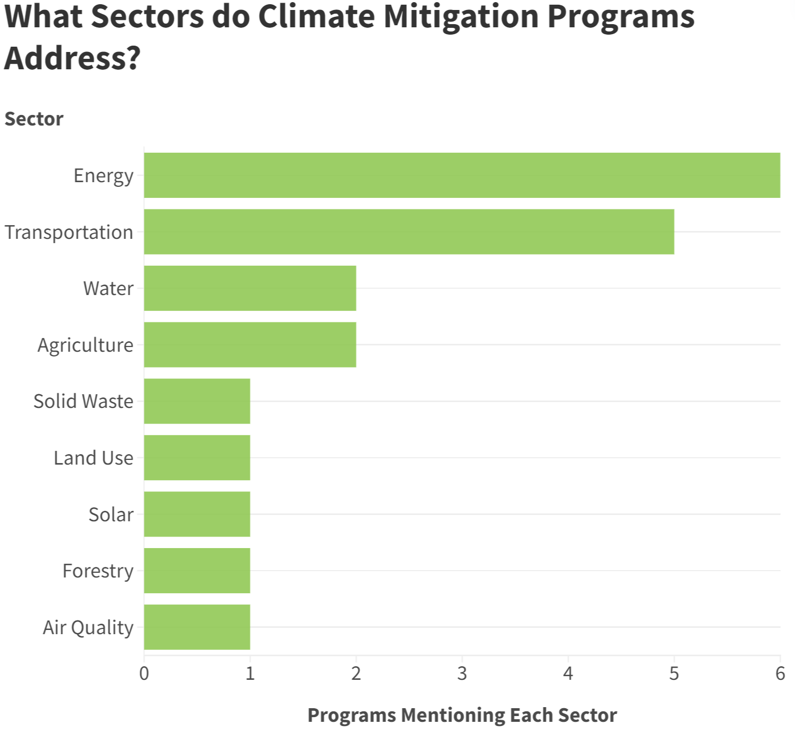
Climate - Mitigation
Climate mitigation strategies primarily target the energy and transportation sectors​
32% of reviewed programs addressed these sectors
​83% of mitigation policies that call out equity communities* in the program scope
These programs are usually not standardized nor continued long-term
Results and impact are often unavailable or unqualified
*Mitigation efforts often aim to support ethnic minorities, low-income and disadvantaged neighborhoods, long-term unhoused, labor organizations, California Native American Tribes, and workforce entities. Definitions of these groups are inconsistent and little data exists on effectiveness of mitigation programs.

Slide 48
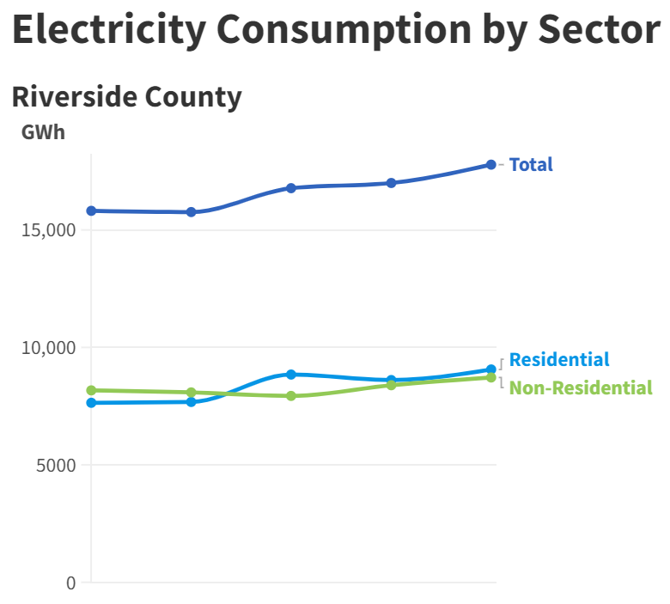
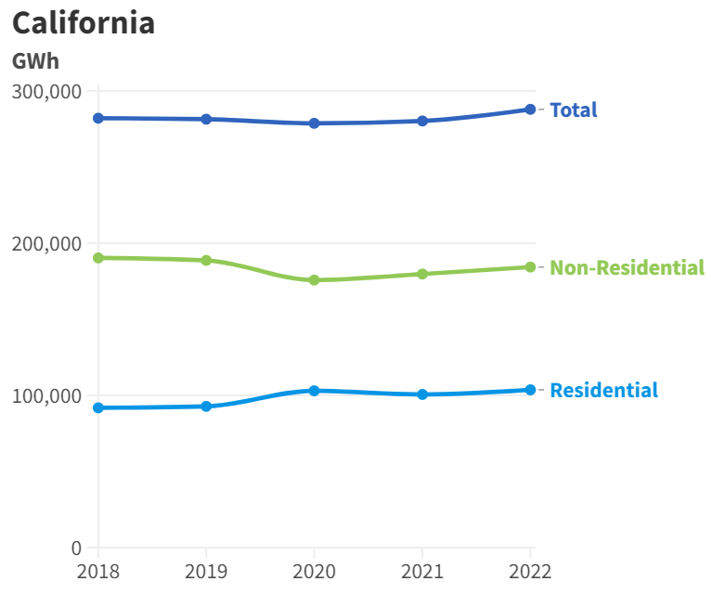
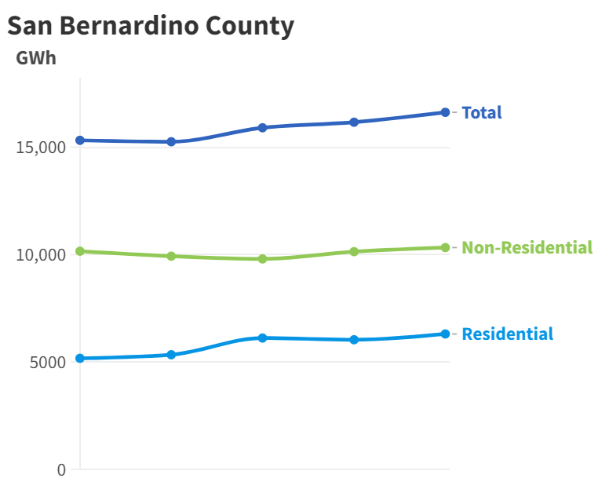
Energy - Consumption
Electricity consumption has risen over time
In 2020, non-residential electricity consumption decreased and residential energy use increased

Slide 49
Slide being updated
Energy - Hydrogen​
Hydrogen Hub Announcement
Project sites will be in both Inland Region counties
Cuts up to 2 million metric tons of carbon emissions every year statewide
Creates an estimated 220,000 new jobs, including 130,000 in construction and 90,000 permanent jobs statewide
40% of the benefits from projects will flow to disadvantaged communities
SoCal Hydrogen Hub approved on 10.13.23: https://newsroom.socalgas.com/press-release/us-department-of-energy-makes-historic-award-for-a-regional-clean-hydrogen-hub-in

Slide 50
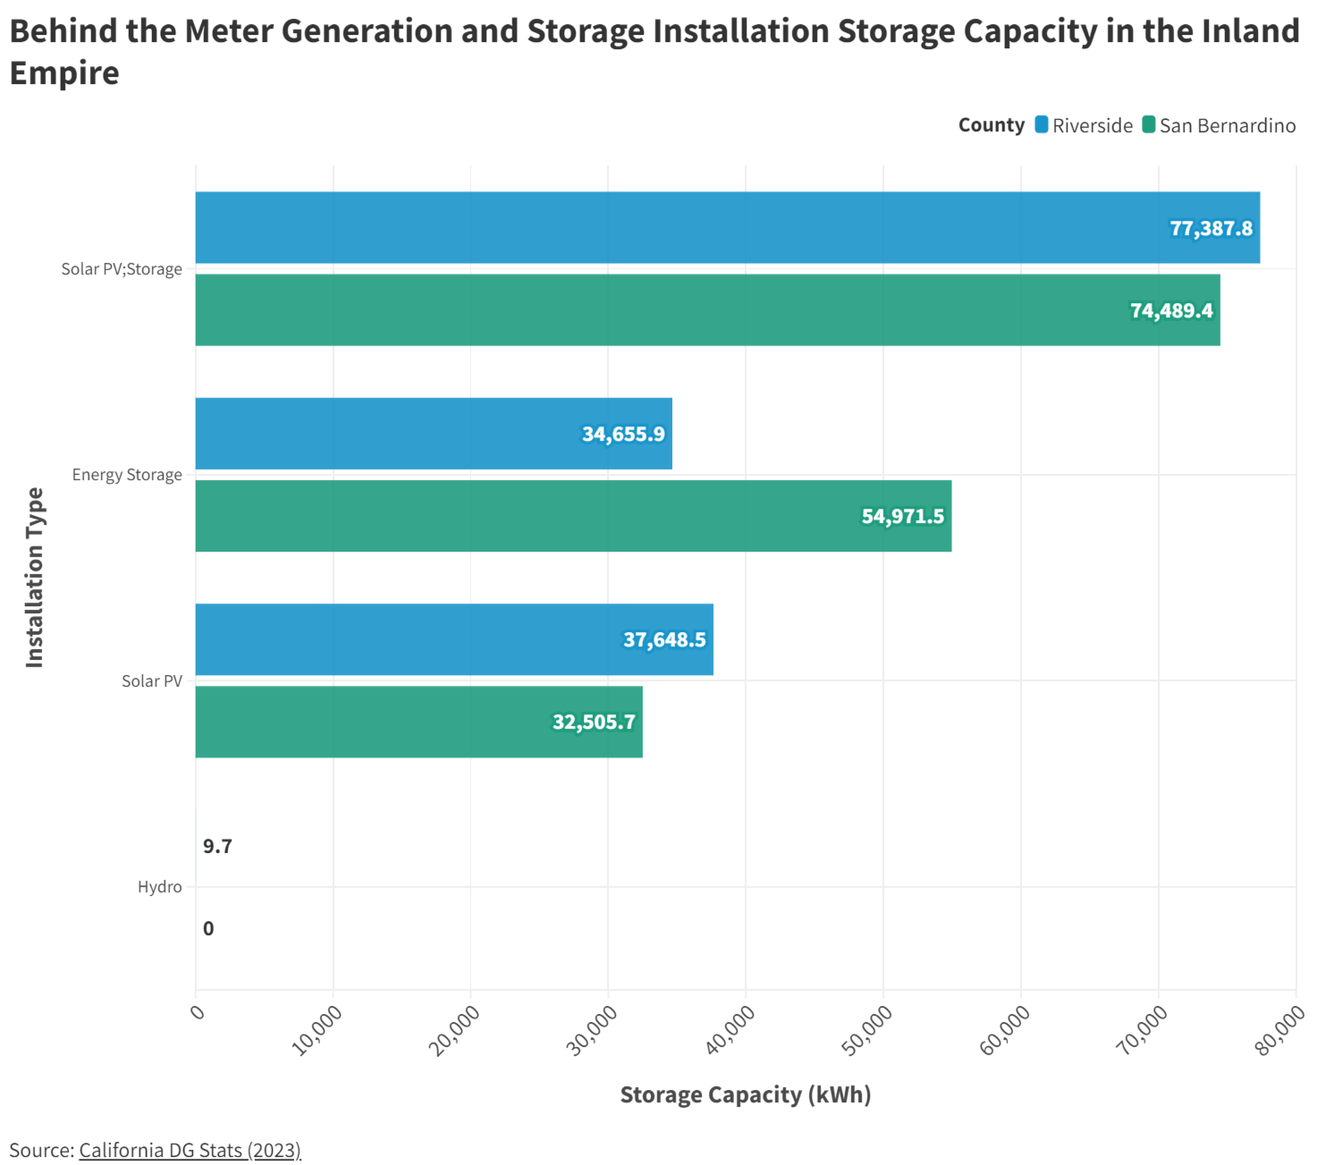
Energy Resiliency​
Distributed energy resources (DERs), such as small-scale generation and storage facilities (battery storage) pivotal to energy resilience
DERs reduce reliance on centralized grids, are crucial in managing peak load demands, and enhance overall grid efficiency
Transformation of the Inland Empire Energy Center into a large-scale energy storage facility and the Crimson Energy Project, a 350-megawatt battery storage system set to enhance regional energy reliability.

